Slide 1
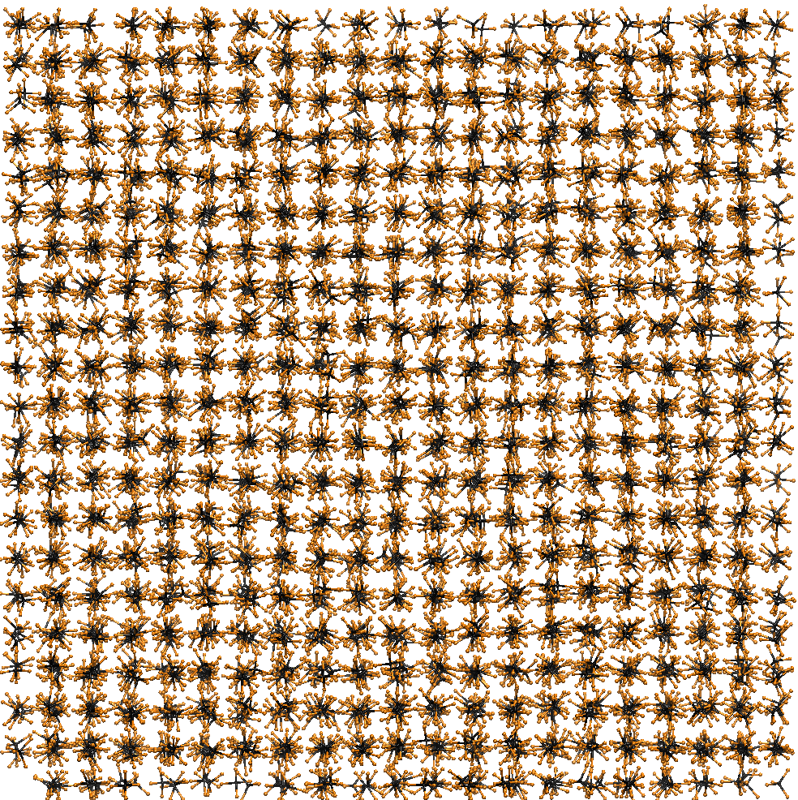
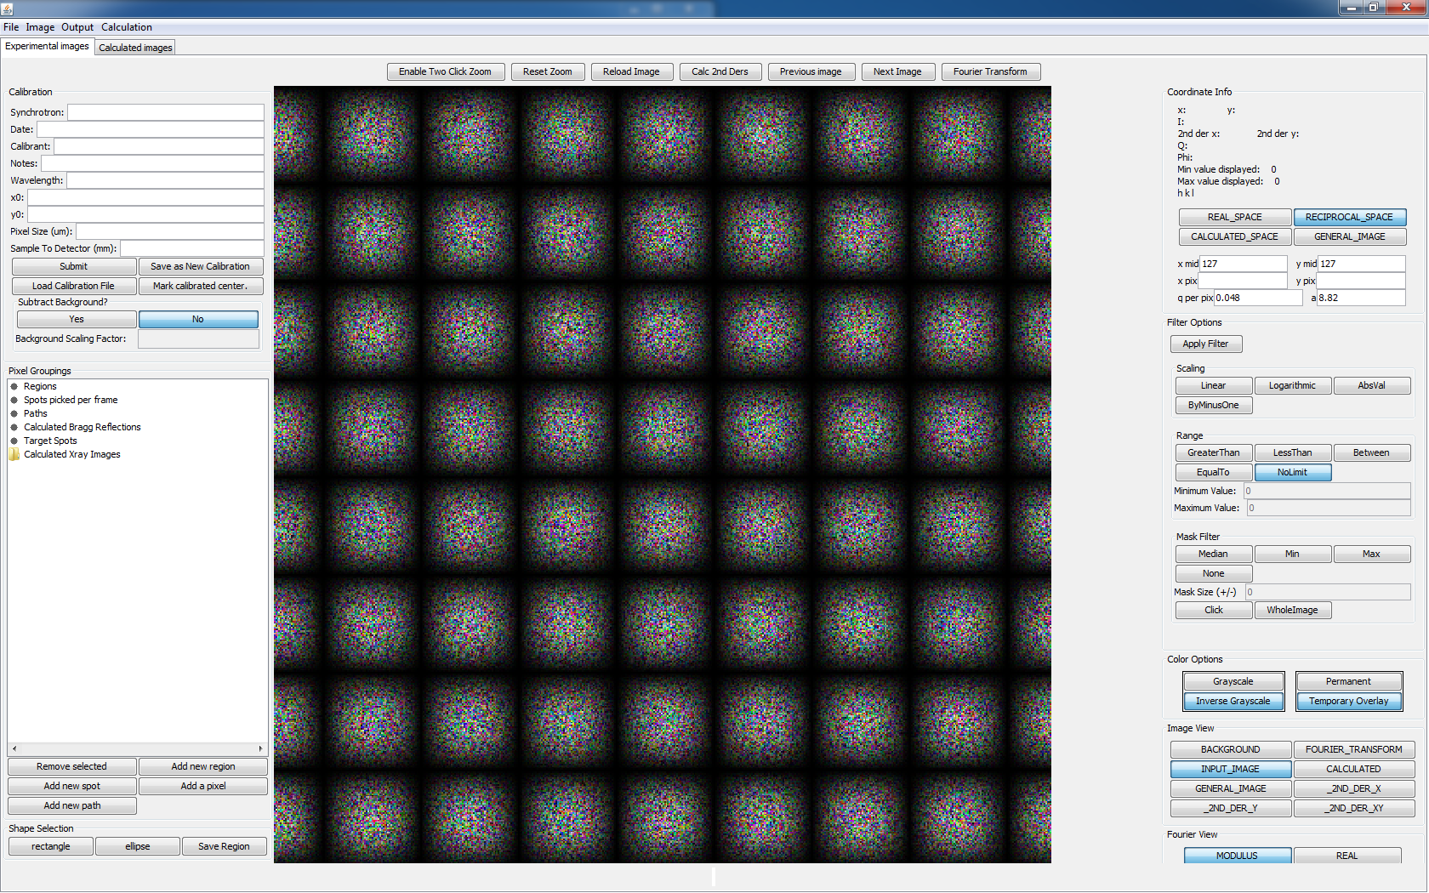
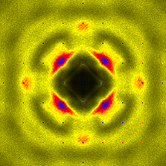
RunSimulationThread.java
Make Lattice
Simulation parameters
Simulation Lattice
Relax Lattice
Write
Calculate Diffraction
Diffraction parameters
Simulation Lattice
Read
Hard drive
Calculate Diffraction Pattern
Write
Run Ramdog
Calculated Diffraction Pattern
Read
Ramdog
Write

Slide 2

a
1
2
b
$$θ$$
3
[111]

Slide 3
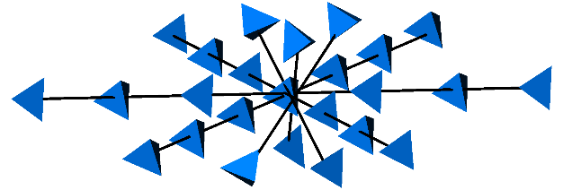
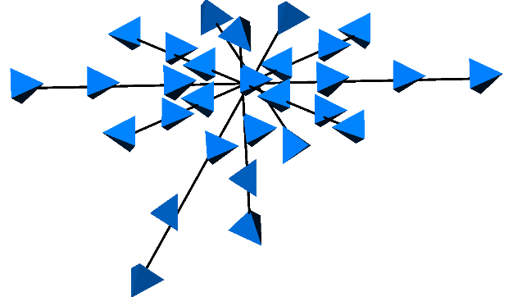
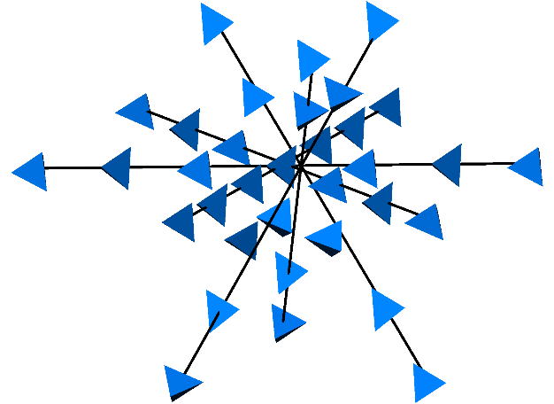
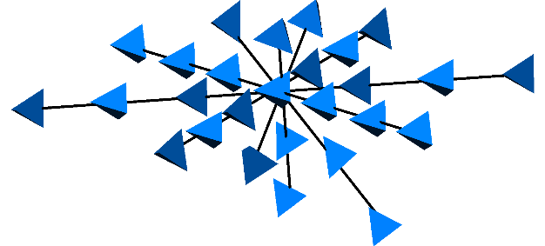
a
c
b
d

Slide 4
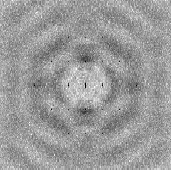
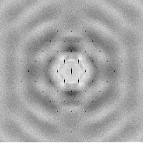
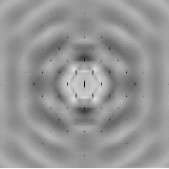
1
10
100

